Slide 1
What is Ajax?
An Asynchronous JavaScript and XML
Technique for creating fast and dynamic web pages
It allows web pages to be updated asynchronously by exchanging small amounts of data with the server behind the scenes
This means that it is possible to update parts of a web page without reloading the whole page
Classic web pages, (which do not use AJAX) must reload the entire page if the content should change
Examples of applications using AJAX: Google Maps, Gmail, YouTube, and Facebook

Slide 2
Advantages of AJAX
Reduce server traffic and increase speed
The first and foremost advantage of Ajax is its ability to improve the performance and usability of web applications.
To explain more detailedly, Ajax techniques allow applications to render without data, which reduces the server traffic inside requests. That being said, web developers can lower the time consumption on both side’s responses significantly.
As a result, your web’s visitors will never have to see a white window and wait for pages to refresh with Ajax implementation.

Slide 3
Enable asynchronous calls
Ajax benefits web developers in how its framework can be used for lazy loading. Those who don’t know what Lazy Loading is are an optimization technique that’s widely used for online content.
In essence, Ajax allows its users to make asynchronous calls to the web server without reloading the whole web page. As a web visitor, you don’t have to wait for the entire page to load entirely in order to access the entire page content.
The concept of lazy loading assists in loading only the required section and delays the remaining, until it is needed by users. Thus, Ajax Lazy Loading not only improves a web page load it also has a positive impact on user experience and conversion rates.

Slide 4
XMLHttpRequest
XMLHttpRequest is a request type widely used for sending a request to Ajax pages. You can also call it with a different name: Asynchronous HTTP request. It plays a vital role in the implementation of Ajax techniques for web development.
XMLHttpRequest transfers and manipulates the XML data to and from a web service using HTTP. Its purpose is to establish an independent connection between the webpage’s client-side and server.

Slide 5
Reduce bandwidth usage
One more advantage of Ajax comes from the bandwidth usage. This action is effective in improving web performance and load speed as well.
Ajax makes the best use of the server’s bandwidth by fetching particle contents instead of transmitting the entire page’s content. This means that you can bring data from the database and store it into the database to perform background without reloading the page.

Slide 6
Form Validation
In contrast to traditional form submission, where client-side validations occur after submission, the AJAX method enables precise and immediate form validation. AJAX provides speed, which is also one of its significant benefits.

Slide 7
Disadvantages of Ajax
Open-source. View source is allowed, and anyone can view the code source written for Ajax, which makes it less secure compared to other technologies
Search Engines cannot index Ajax pages can not be indexed by Google as well as other search engines
The usage of Ajax can cause difficulties for your web pages to debug as well as make them prone to possible security issues in the future
Most importantly, Ajax has a considerable dependency on JavaScript, so only browsers that support Javascripts or XMLHttpRequest can use pages with Ajax techniques
Users will find it challenging to bookmark a specific state of the application due to the dynamic web page

Slide 8
Why use Ajax?
Client/Server Apps:
Dynamic data
Static forms, controls, code, etc
Efficient, but not flexible
Traditional Web Apps:
Dynamic data
Dynamic forms, controls, code, etc
Flexible, but inefficient, and noticeably slow
Ajax Apps:
Dynamic data
Static or dynamic forms, controls, code, etc
Best of both worlds

Slide 9
Why use Ajax?
Multithreaded data retrieval from Web servers
Pre-fetch data before needed
Progress indicators
Appearance of speed
Avoids need for setTimeout()
Less bandwidth required; less server load
Reload partial page, not entire page
Load data only, not even partial page

Slide 10
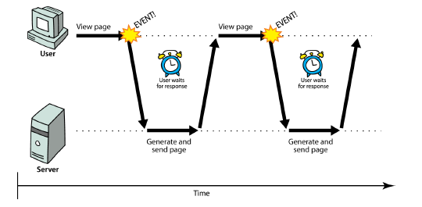
Synchronous web communication
synchronous: user must wait while new pages load
the typical communication pattern used in web pages (click, wait, refresh)

Slide 11
Web applications and Ajax
web application: a dynamic web site that mimics the feel of a desktop app
presents a continuous user experience rather than disjoint pages
examples: Gmail, Google Maps, Google Docs and Spreadsheets, Flickr, A9

Slide 12
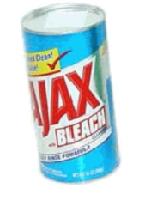
Web applications and Ajax
Ajax: Asynchronous JavaScript and XML
not a programming language; a particular way of using JavaScript
downloads data from a server in the background
allows dynamically updating a page without making the user wait
avoids the "click-wait-refresh" pattern
Example: Google Suggest

Slide 13
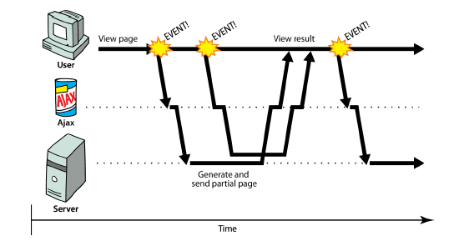
Asynchronous web communication
asynchronous: user can keep interacting with page while data loads
communication pattern made possible by Ajax

Slide 14
XMLHttpRequest (and why we won't use it)
JavaScript includes an XMLHttpRequest object that can fetch files from a web server
supported in IE5+, Safari, Firefox, Opera, Chrome, etc. (with minor compatibilities)
it can do this asynchronously (in the background, transparent to user)
the contents of the fetched file can be put into current web page using the DOM

Slide 15
XMLHttpRequest (and why we won't use it)
sounds great!...
... but it is clunky to use, and has various browser incompatibilities
Prototype provides a better wrapper for Ajax, so we will use that instead

Slide 16
A typical Ajax request
user clicks, invoking an event handler
handler's code creates an XMLHttpRequest object
XMLHttpRequest object requests page from server
server retrieves appropriate data, sends it back
XMLHttpRequest fires an event when data arrives
this is often called a callback
you can attach a handler function to this event
your callback event handler processes the data and displays it

Slide 17
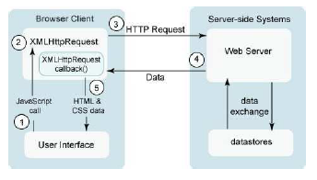
A typical Ajax request

Slide 18
Prototype's Ajax model
new Ajax.Request("url",
{
option : value,
option : value,
...
option : value
}
); JS
construct a Prototype Ajax.Request object to request a page from a server using Ajax
constructor accepts 2 parameters:
the URL to 1. fetch, as a String,
a set of options, as an array of key : value pairs in {} braces (an anonymous JS object)
Notes:
2.
hides icky details from the raw XMLHttpRequest; works well in all browsers

Slide 19
Prototype Ajax methods and properties
option | description
method | how to fetch the request from the server (default "post")
parameters | query parameters to pass to the server, if any
asynchronous (default true), contentType, encoding, requestHeaders
options that can be passed to the Ajax.Request constructor

Slide 20
Prototype Ajax methods and properties
event | description
onSuccess | request completed successfully
onFailure | request was unsuccessful
onException | request has a syntax error, security error, etc.
events in the Ajax.Request object that you can handle

Slide 21
Basic Prototype Ajax template
property | description
status | the request's HTTP error code (200 = OK, etc.)
statusText | HTTP error code text
responseText | the entire text of the fetched page, as a String
responseXML | the entire contents of the fetched page, as an XML DOM tree (seen later)
function handleRequest(ajax) {
alert(ajax.responseText);
} JS

Slide 22
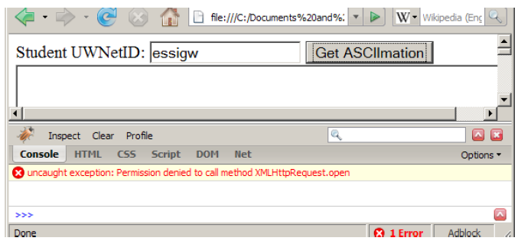
XMLHttpRequest security restrictions
cannot be run from a web page stored on your hard drive
can only be run on a web page stored on a web server
can only fetch files from the same site that the page is on www.foo.com/a/b/c.html can only fetch from www.foo.com

Slide 23
Handling Ajax errors
new Ajax.Request("url",
{
method: "get",
onSuccess: functionName,
onFailure: ajaxFailure,
onException: ajaxFailure
}
);
...
function ajaxFailure(ajax, exception) {
alert("Error making Ajax request:" + "\n\nServer status:\n" + ajax.status + " " + ajax.statusText +
"\n\nServer response text:\n" + ajax.responseText);
if (exception) {
throw exception;
}
} JS
for user's (and developer's) benefit, show an error message if a request fails
Notes:
for user's (and developer's) benefit, show an error message if a request fails

Slide 24
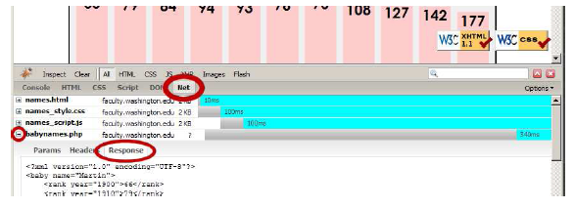
Debugging Ajax code
Net tab shows each request, its parameters, response, any errors
expand a request with + and look at Response tab to see Ajax result

Slide 25
Creating a POST request
new Ajax.Request("url",
{
method: "post", // optional
parameters: { name: value, name: value, ..., name: value },
onSuccess: functionName,
onFailure: functionName,
onException: functionName
}
); JS
Notes:
http://www.tizag.com/ajaxTutorial/index.php

Slide 26
Creating a POST request
Ajax.Request can also be used to post data to a web server
method should be changed to "post" (or omitted; post is default)
any query parameters should be passed as a parameters parameter
written between {} braces as a set of name : value pairs (another anonymous object)
get request parameters can also be passed this way, if you like

Slide 27
Prototype's Ajax Updater
new Ajax.Updater(
"id",
"url",
{
method: "get"
}
); JS
Ajax.Updater fetches a file and injects its content into an element as innerHTML
additional (1st) parameter specifies the id of element to inject into

Slide 28
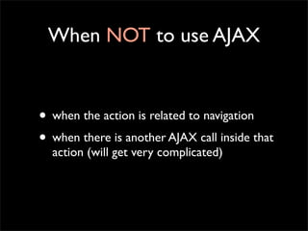

Slide 29
What Advances have Been Made to Ajax?
JavaScript is the client-side programming language and XML is a markup language to define data.
JSON is another markup language to define data. JSON (JavaScript Object Notation) is much easier to use with JavaScript than XML.
When it comes to Ajax and JavaScript, JSON Web Services are replacing XML Web Services.
Another major advance to JavaScript and Ajax is the JavaScript object library called jQuery.
This free, open-source software is a wrapper around JavaScript.
jQuery is used to easily write client-side JavaScript to navigate and manipulate a page and make asynchronous Ajax callbacks.
By using jQuery and JSON Web Services, Ajax callbacks have become standard programming practices for designing and developing web applications.

Slide 30
AJAX Application Example
Online test
Many multiple choice questions
All questions are displayed on one page
After the user answers one question, the correct answer and explanation about why the user answer is wrong is shown on the page
For all already-answered questions, their correct answers and explanations are always shown on the page
Pure sever-side solution using conventional web application

Slide 31
For each question answer submission, the whole page with most of repeated data sent to the browser
Pure client-side solution using conventional JavaScript. The user can read JavaScript source code to view what is correct answer
Large amount of explanation data will be carried by the JavaScript codeAJAX solution
After the user answers a question, use XmlHttpRequest to ask the server to send the correct answer and explanation. Display the correct answer and explanation received from the server.

